Slide 1

Arduino Calculator
Created by SAJIB and BUDHVIN

Slide 2
CONTENTS
What is an Arduino Calculator
Materials required for Arduino calculator
Difference between Arduino Calculator and normal calculator
Circuit diagram
Complete design of Arduino calculator

Slide 3

Objective for our project
Setting UP A Arduino calculator
Connect lcd to enabled device to the Arduino
Connect switch and potentiometer to Arduino
Deploy program for the lcd enabled device
Configure and test program for lcd enabled device
Propose a possible application to the hardware created

Slide 4

What is an Arduino Calculator ?
A simple Arduino Based Calculator using Keypad & LCD for Solving Mathematical Calculations can be easily implemented using Arduino, LCD, and Keypad. A simple mathematical calculation like Addition, Subtraction, Multiplication, and Division can easily do using this project.

Slide 5
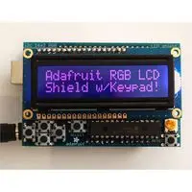


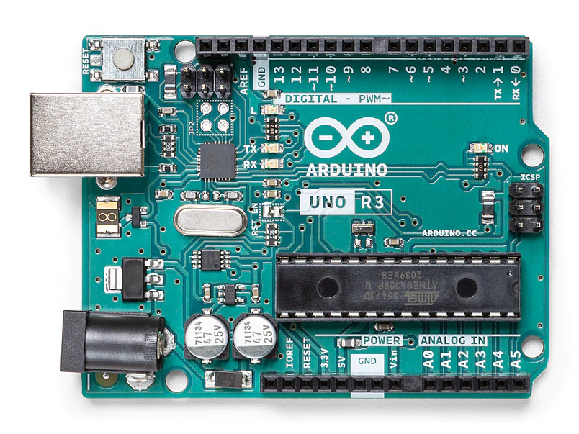
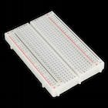
Materials required for Arduino calculator
Arduino Uno (Any version will work)
16×2 LCD Display
4×4 Keypad
9V Battery
Breadboard and Connecting wires

Slide 6
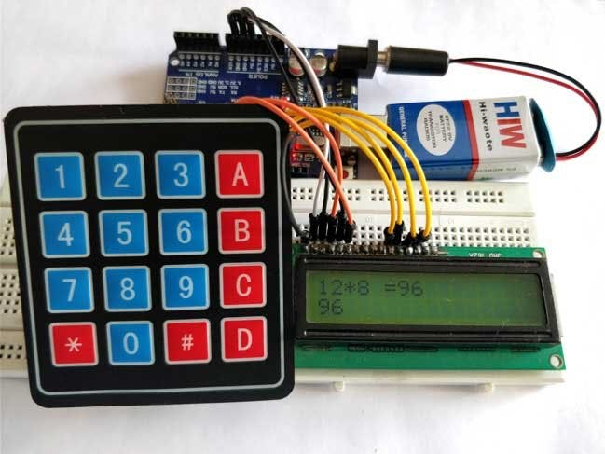
Difference between Arduino Calculator and normal calculator
The difference between Arduino Calculator and normal calculator is that if were to use an Arduino calculator to add,subtract,multiply or divide numbers we would use the 4X4 keypad by using alphabets for normal calculator we would use all the numbers and it is also easier as the symbols are provided .

Slide 7
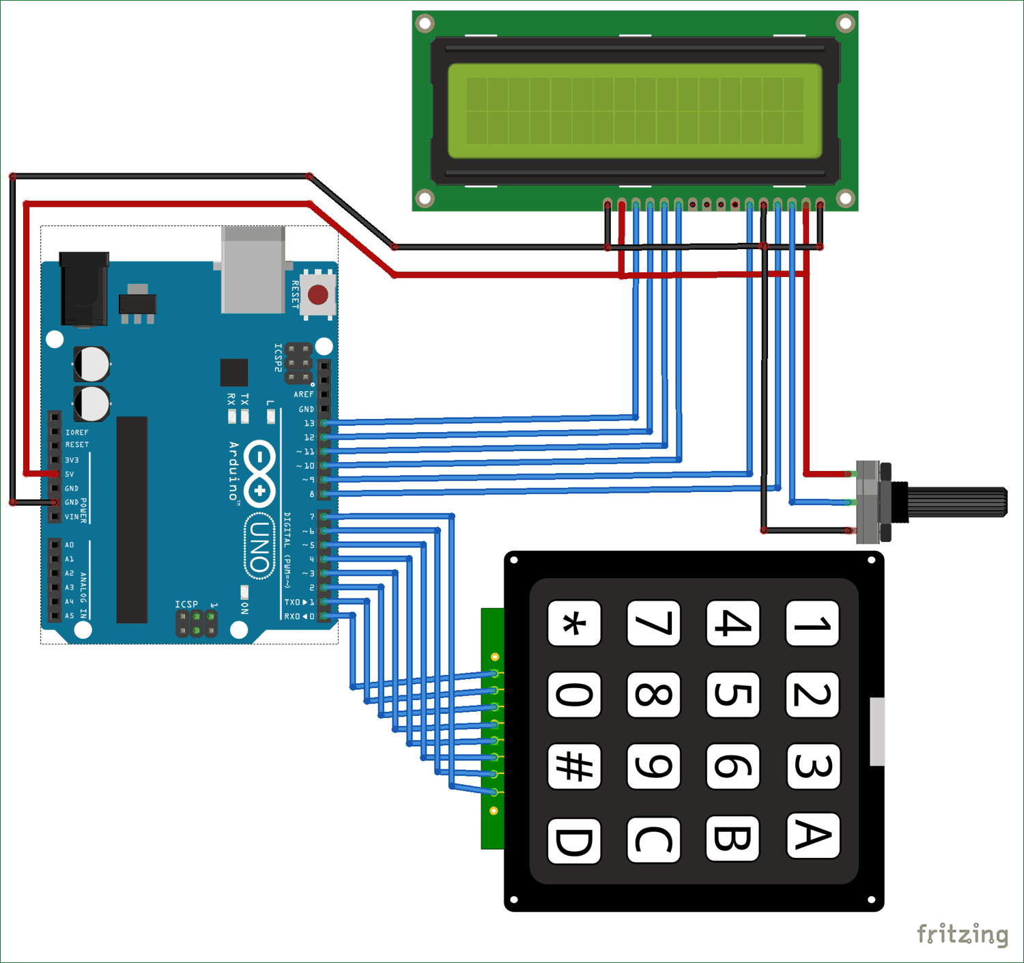




Circuit diagram

Slide 8
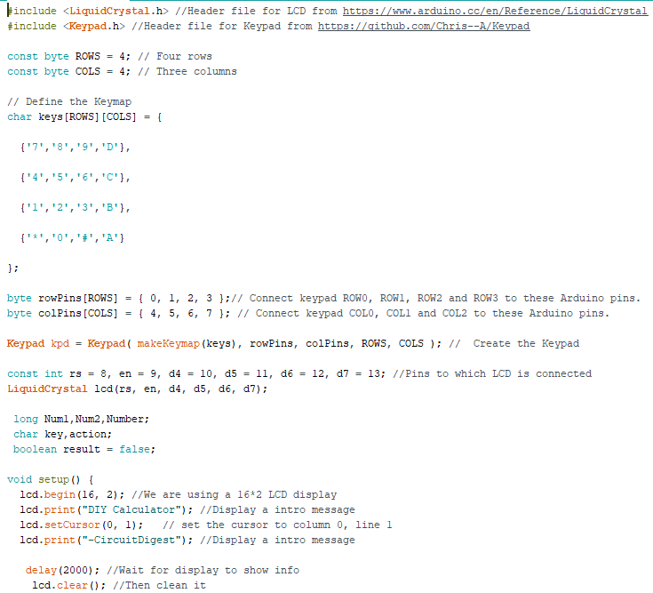
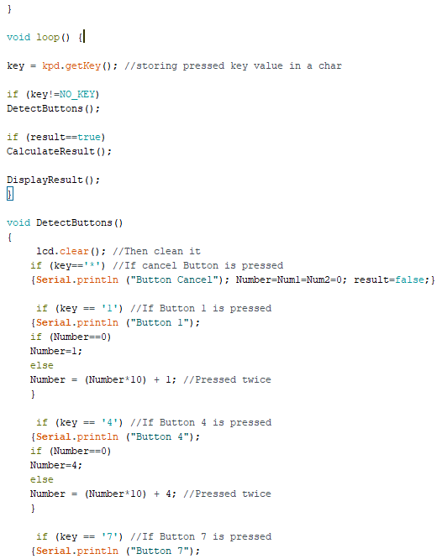
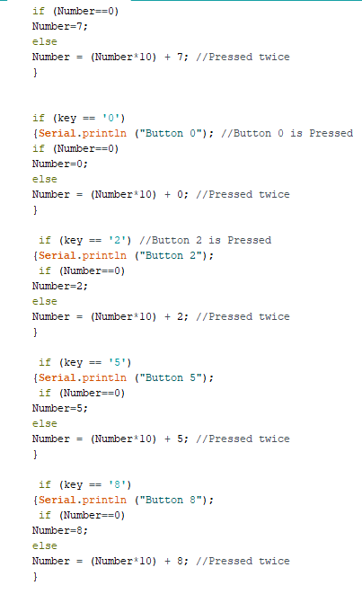
Code(part 1)

Slide 9
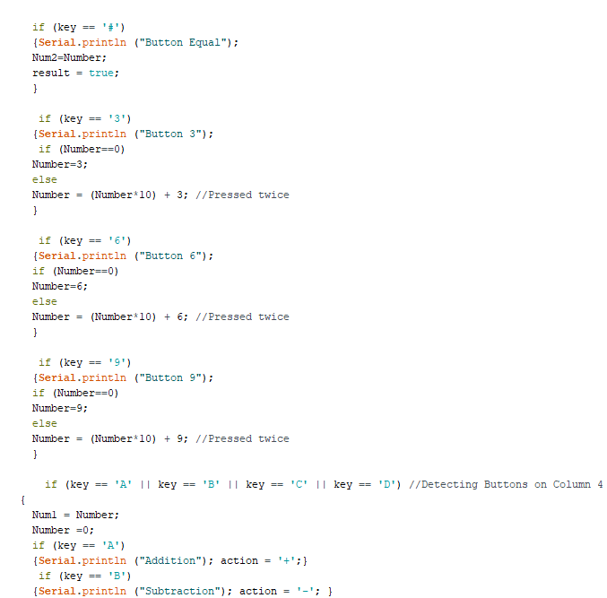
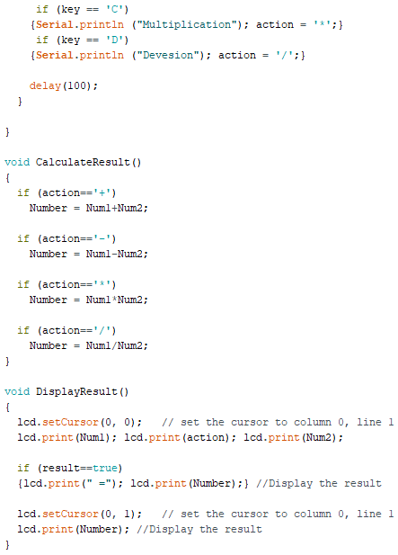
Code(part 2)

Slide 10
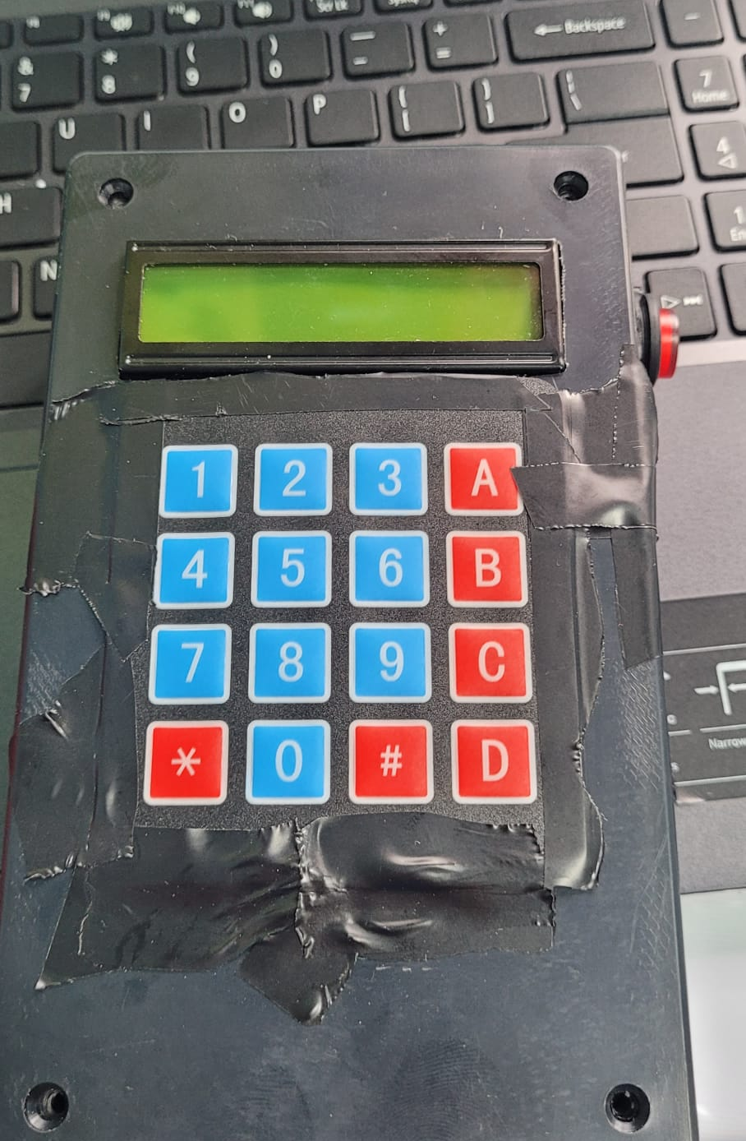
Completed product off our Arduino calculator

Slide 11
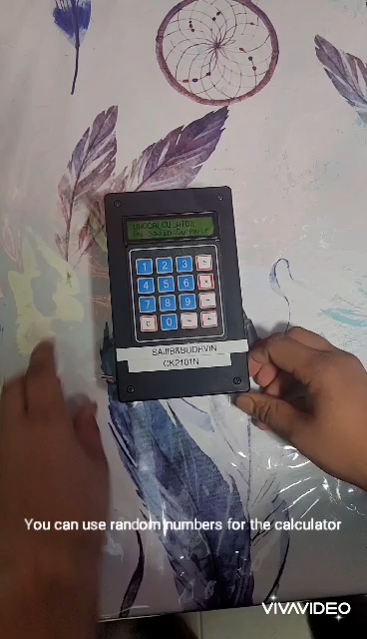
Video

Slide 12
Summary and learning points
. We learned how to make a calculator through Arduino
1
. We learned how the code works through out the system
2
. We learned the differences between a normal calculator and a Arduino calculator .
3

